Slide 1
Fashion MNIST
Deep Learning
ST1504
Soh Hong Yu
P2100775
DAAA/FT/2B/01

Slide 2
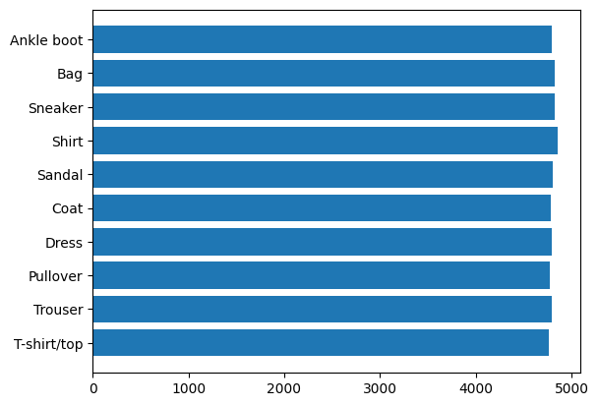
Exploratory Data Analysis
As the training set will be used to train the model, we will need a set of data for model tuning, and the testing set will be used to evaluate the final model, ensuring the model is generalise and not overfit to the validation set due to model tuning.
To decide what size of the validation set, I have decided to split the data by 80:20 of the train set as the validation set.
Encoded Values
0 : T-shirt/top
1 : Trouser
2 : Pullover
3 : Dress
4 : Coat
IMG_SIZE = (28, 28, 1)
Distribution is even, Accuracy can be used as a scoring metrics
5 : Sandal
6 : Shirt
7 : Sneaker
8 : Bag
9 : Ankle boot

Slide 3
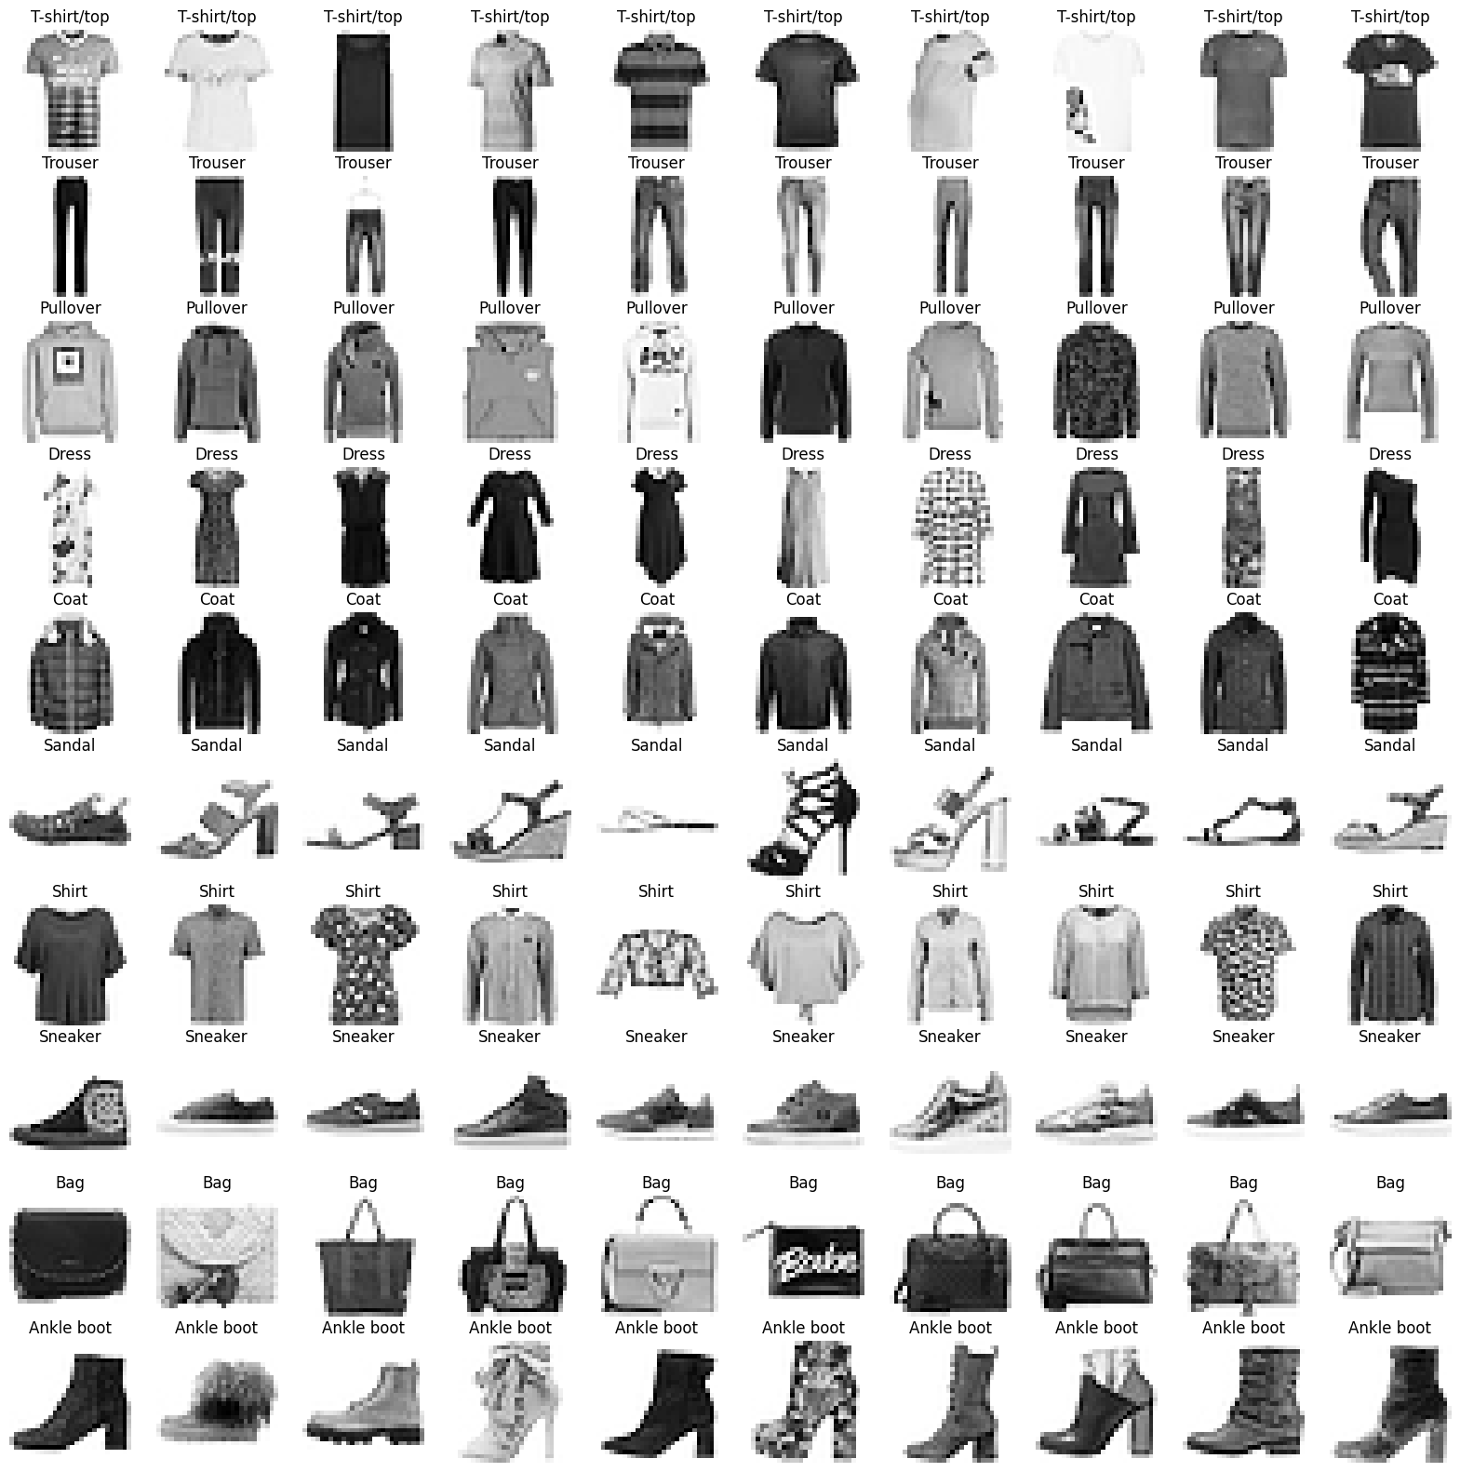
Exploratory Data Analysis
Zalando is very consistent in the orientation of the images.
The shoes always seem to have their tip pointing to the left
Data augmentation where images can be flipped could be possible to do better prediction
The images are zoomed in so that the entire image is only the item.
Based on the selection of images which are 10 from each class [Total 100 samples], There is no clear indication of missed identified items/wrongly augmented items from the dataset. [No extra cleaning/data labelling is required]

Slide 4
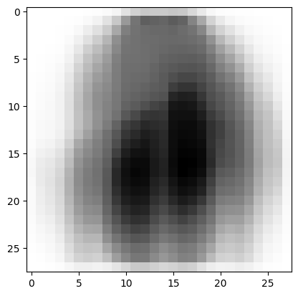
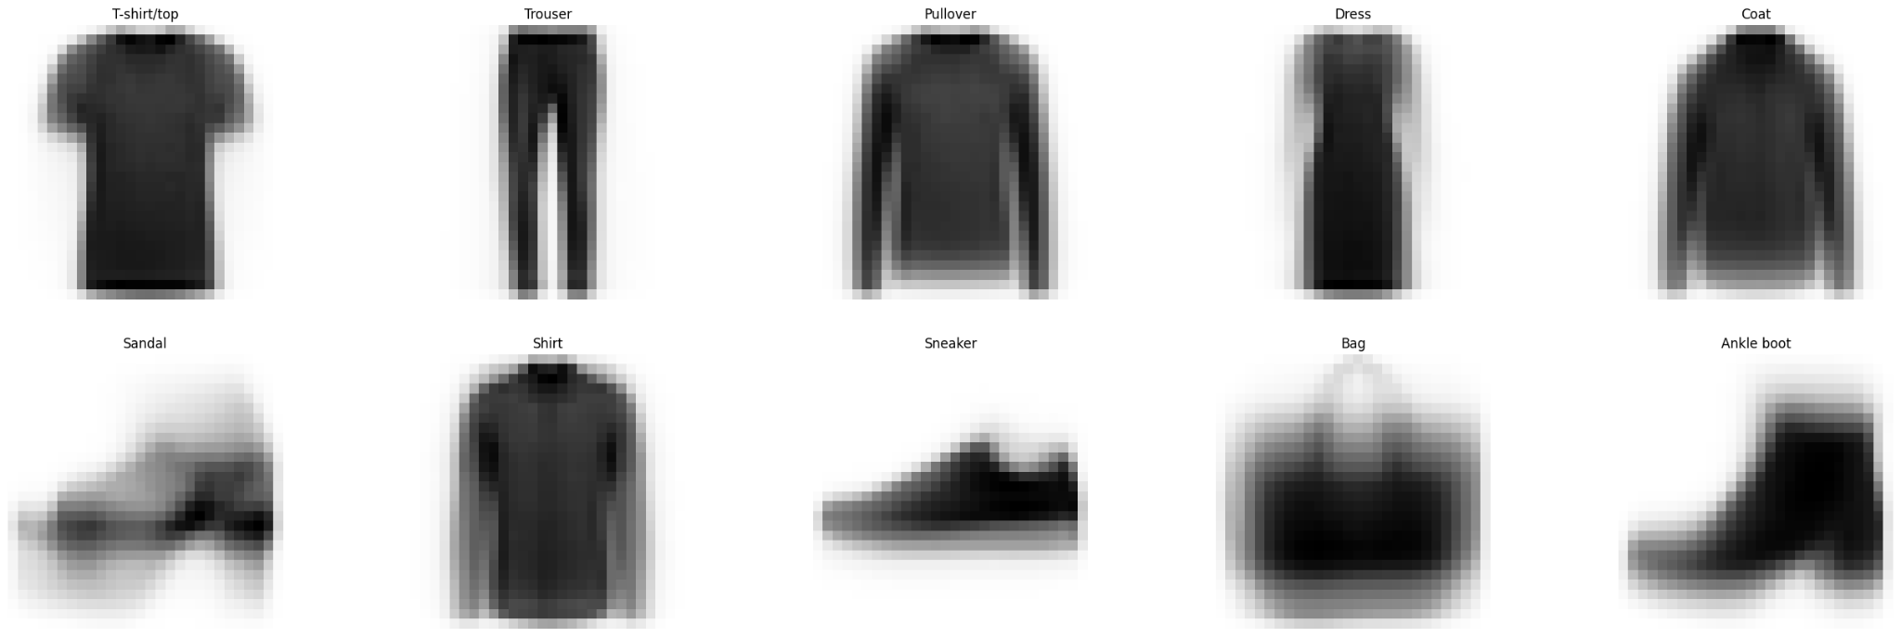
Image Averaging
To look through all the dataset, we will apply a technique called Image Averaging. It stacks all images in the dataset and average each other. This allows us to look at the noise of the dataset and all images per class.
We can see that the images from each class is very clear but there are similar classes like pullovers, coats and shirts.
As the corners of the images are not touched, image padding is not required

Slide 5

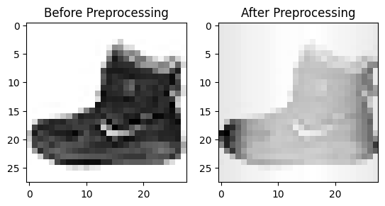
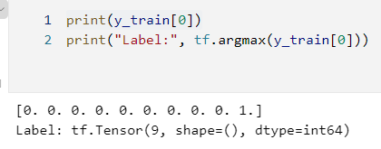
Data Preprocessing
Using tf.utils.to_categorical to one hot encode the labels
Use the Normalisation layer to normalise the image pixels

Slide 6
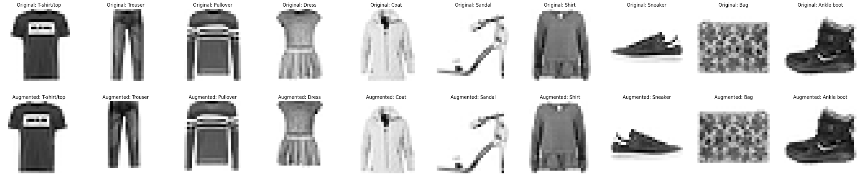
Data Augmentation
To prevent overfitting, we will apply data augmentation.
For this augmentation we will be using random flipping and translation up and down. This is because clothing are symmetrical and it gives the model a more generalised idea of the data. From the average images, we note that the images are some long and some short, therefore by shifting the images up and down it allows the model to know more about the lines and it’s relationship.

Slide 7
Building Models
To build our deep learning models, we will be using the different lists.
Fully Connected Neural Network Model (Baseline)
Conv2D Neural Network Model
CustomVGG Model
CustomResNet Model
We will be using EarlyStopping to prevent overfitting,
and using the SGD optimizer instead of Adam. This is because Adam will take “shortcuts” and using a coordinate wise gradient clipping method. This makes it hard for classification as every detail of an image is important and therefore SGD is the more appropriate optimizer.

Slide 8
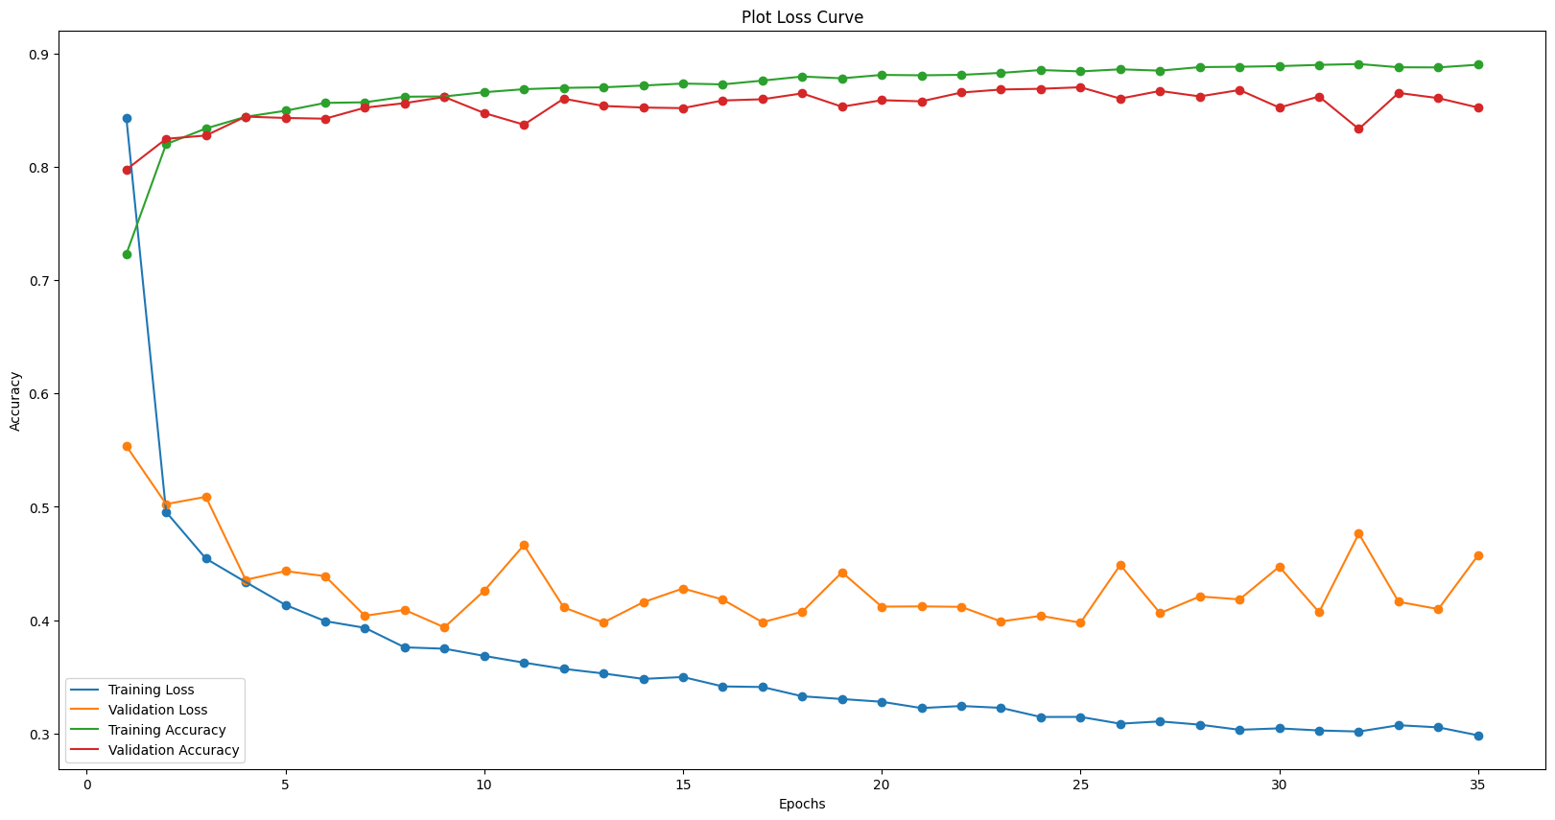
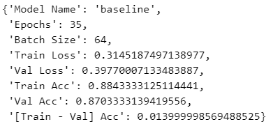
Baseline Model
We will build a baseline model with 3 hidden Dense layer.
From the loss curve, we see that the model becomes generalised and loss functions starts to decreases. However, there are spikes and sudden drops in the accuracy.

Slide 9
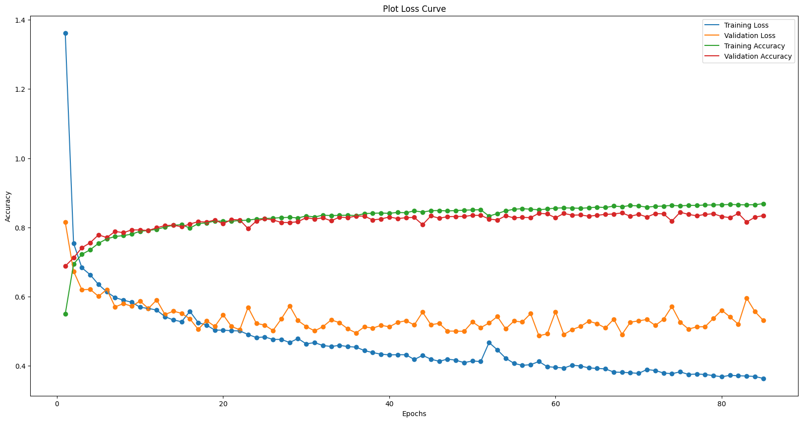
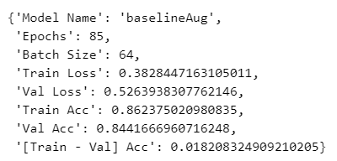
Baseline Model - Aug
Comparing the augmented dataset, the model performs worse and become less accurate. This is likely due to the validation data not having augmented data and the augmentation used did not help the model understand patterns more easily. This also shows that augmentation of the data might not the best method to improve accuracy.

Slide 10
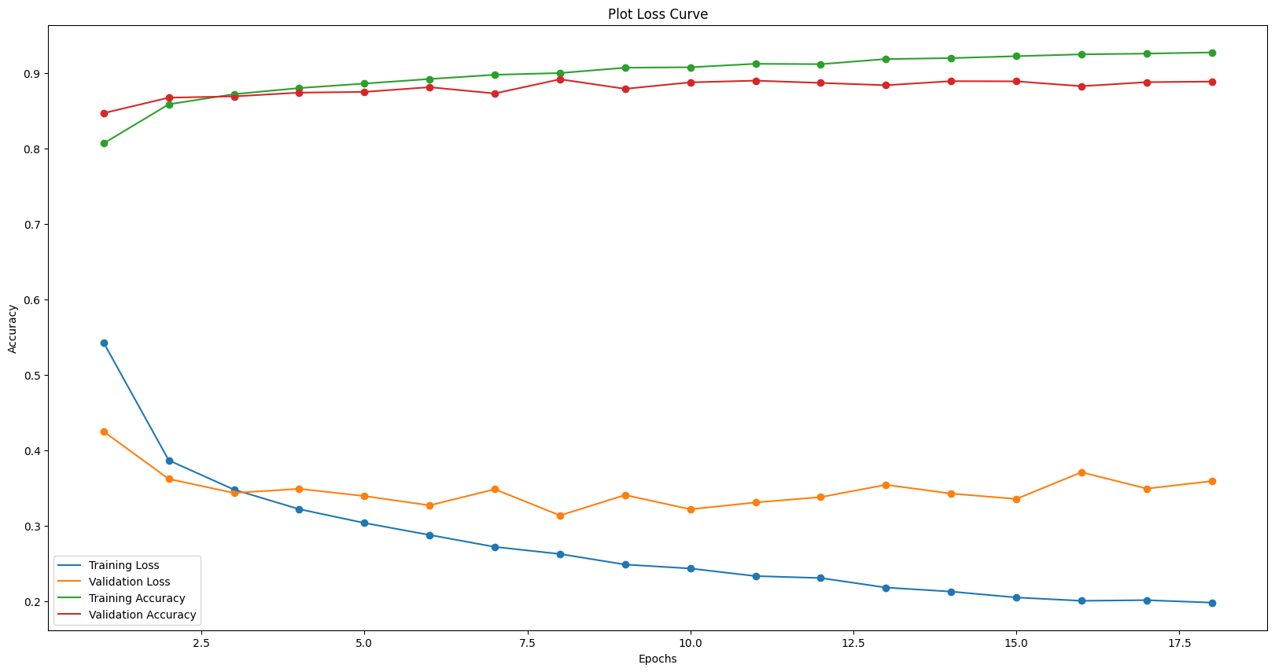
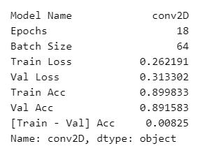
Conv2D Model
We will build a conv2D model with 3 hidden Conv2D layer. We can see that the conv2D model performs better than the baseline model not only because the accuracy increase but also the loss values decreasing. This shows that the conv2D model is able to use neighbouring pixels to help in the prediction of understanding the different features of the images.

Slide 11
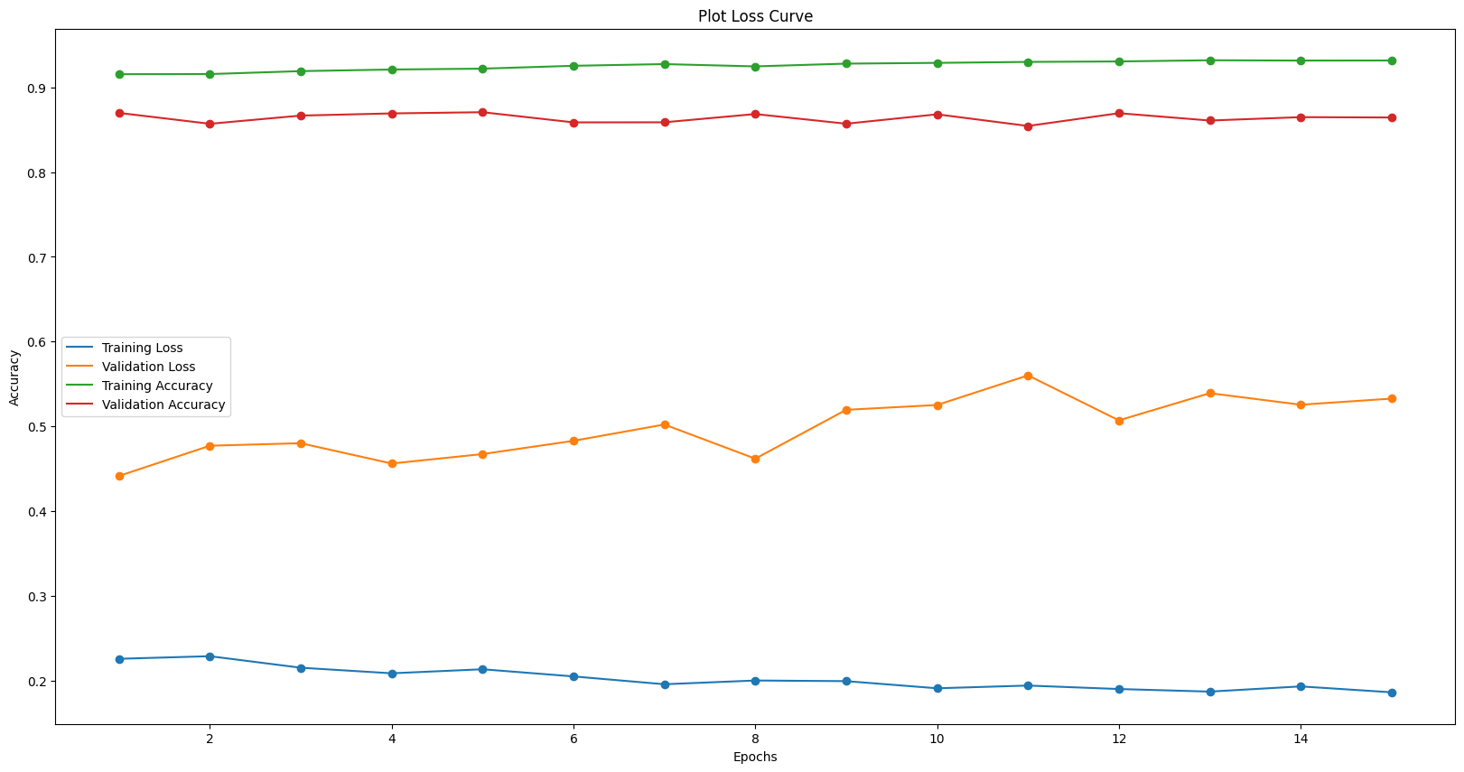
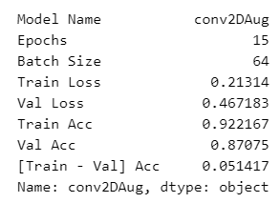
Conv2D Model - Aug
Comparing out conv2D model with aug compared to our conv2D model without aug, we can clearly see that conv2D model without aug performed better than conv2D model with aug in terms of validation accuracy. However, the training accuracy increased which suggest that with the conv2D layers, the model is able to better predict the augmented data. [overfit]

Slide 12
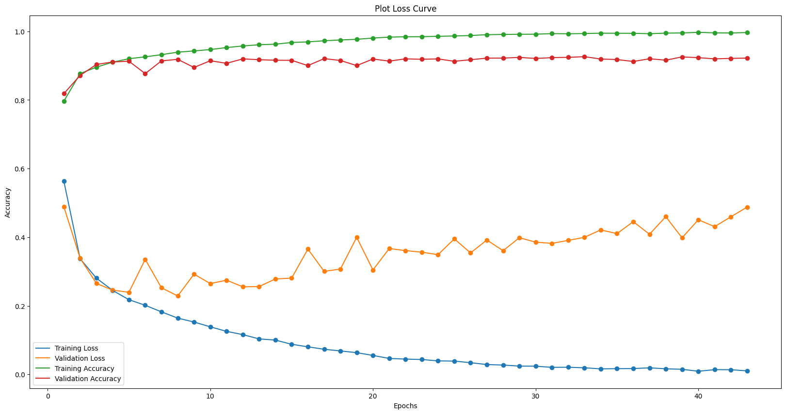
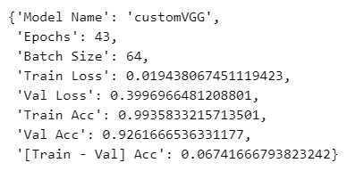
CustomVGG Model
We will build a CustomVGG model with 10 hidden layer [VGG-10].
Comparing our CustomVGGModel with our baseline model, we can see that the VGG model is able to predict and classify the images better with higher accuracy and is generalising the data. As the validation loss increased over time with more epochs, it seems that the VGG model is quite overfitted. To reduce the validation loss, we will try to use the augmented data.

Slide 13
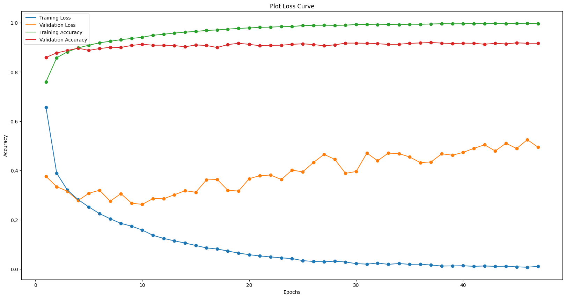
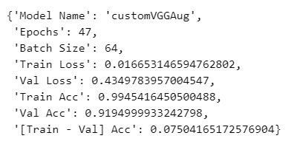
CustomVGG Model -Aug
Comparing our CustomVGGModel with aug to our CustomVGGModel without aug, we note that the train accuracy is higher but the test accuracy is lower but it is not as significant compared to the other models. However, the validation loss is still higher than the none augmented data. This suggest that more needs to be done like regularisation or other forms of data augmentation.

Slide 14
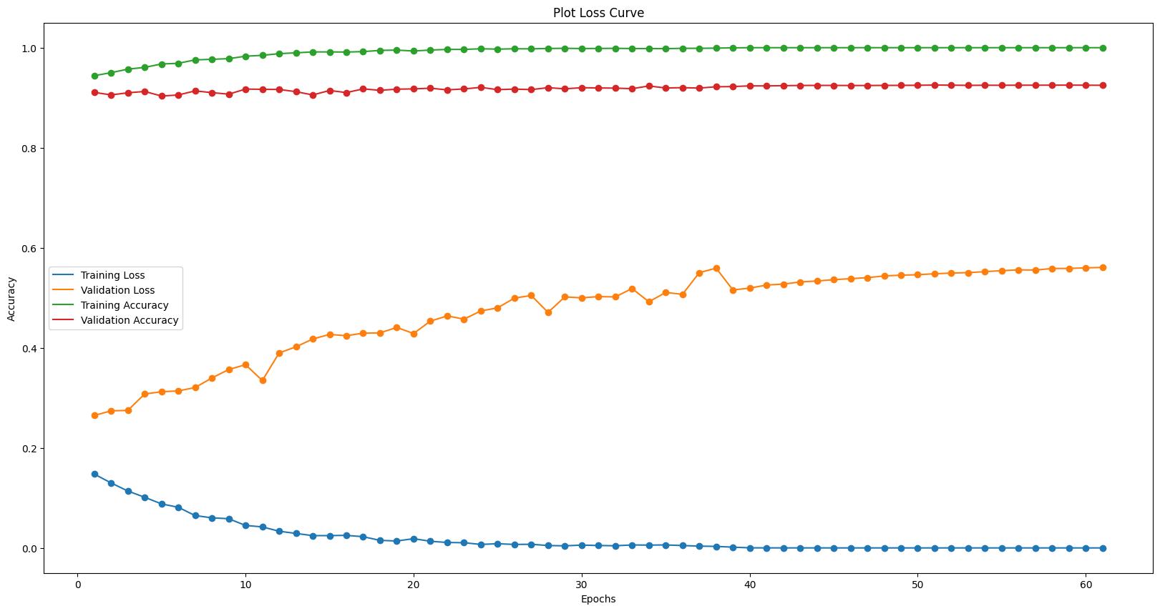
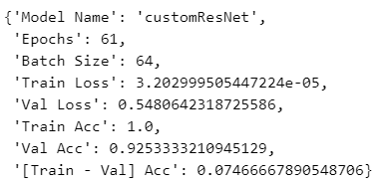
CustomResNet Model
We will build a CustomResNet model with 10 hidden layer [ResNet-10].
Comparing CustomResNet to the baseline model, we can see that the CustomResNet model is very good compared to the baseline in terms of both training and validation accuracy. However, the issue is that the validation loss function increase over epochs. We also note that the model is able to be very good at a low epochs and not become too overfit [Not overfitted easily as epochs is very high before Early Stopping kicks in]

Slide 15
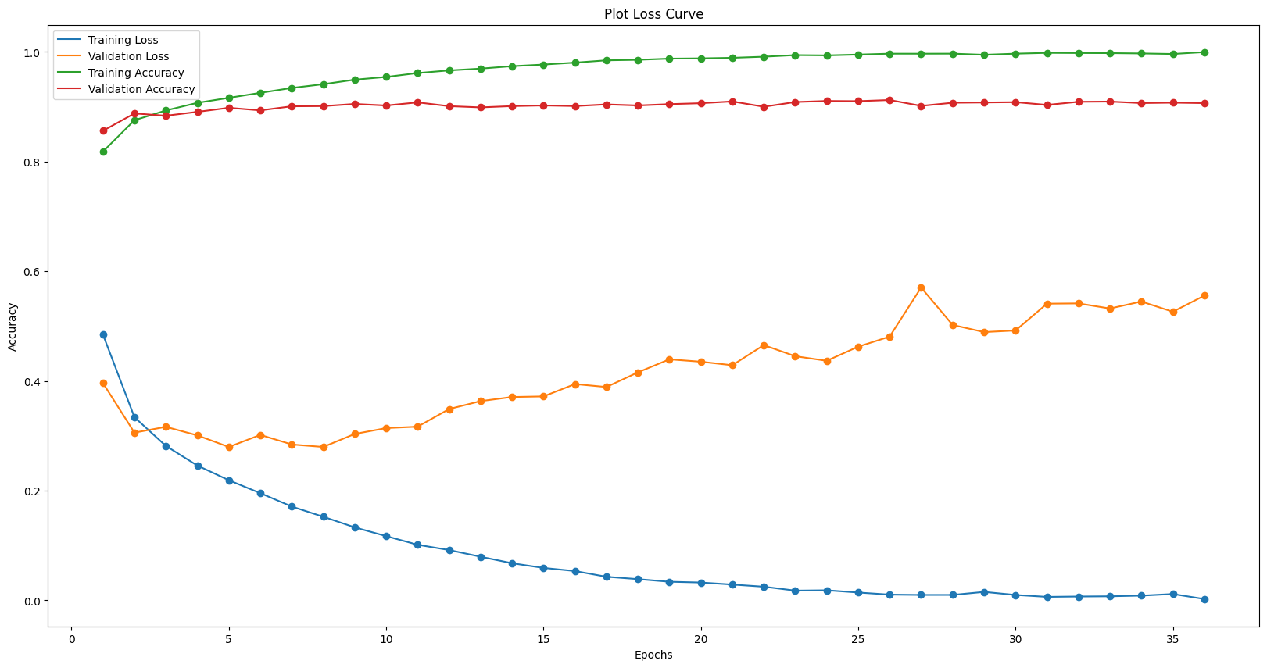
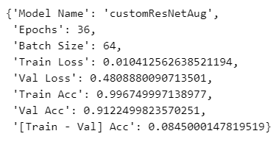
CustomResNet Model - Aug
Comparing the CustomResNet with data augmentation and CustomResNet without data augmentation, we note that the validation loss decrease which means that the augmentation allowed the model to fit more to the validation set. However, despite that both accuracy dropped which suggest that training using only validation set affected some of the training.

Slide 16
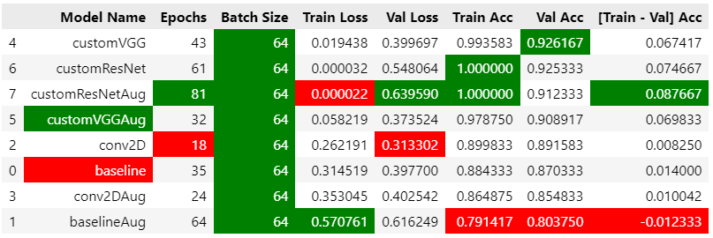
Model Selection
To choose and select which model is the best model, we will be looking at the Results table. This results table shows that the CustomVGG model outperforms other models in terms of validation accuracy. However, the CustomResNet model is also very strong but is has a lower validation accuracy than the CustomVGG. This is likely due to the number of layers we set for the ResNet model. SOTA ResNet models are 34, 50 and 101 layers. But our implementation is a ResNet10 model. However this also shows the power of the VGG model.
Therefore for model
improvements, we will be
focusing on VGG and ResNet.

Slide 17
Model Improvement - VGG
For the VGG model, we will be trying a few things.
Using different regularisation methods (L1 and L2)
Using different optimizers [SGD vs Adam]
Using a learning rate scheduler [Cosine Annealing]
Using keras tuner to GridSearch to find the best parameters

Slide 18
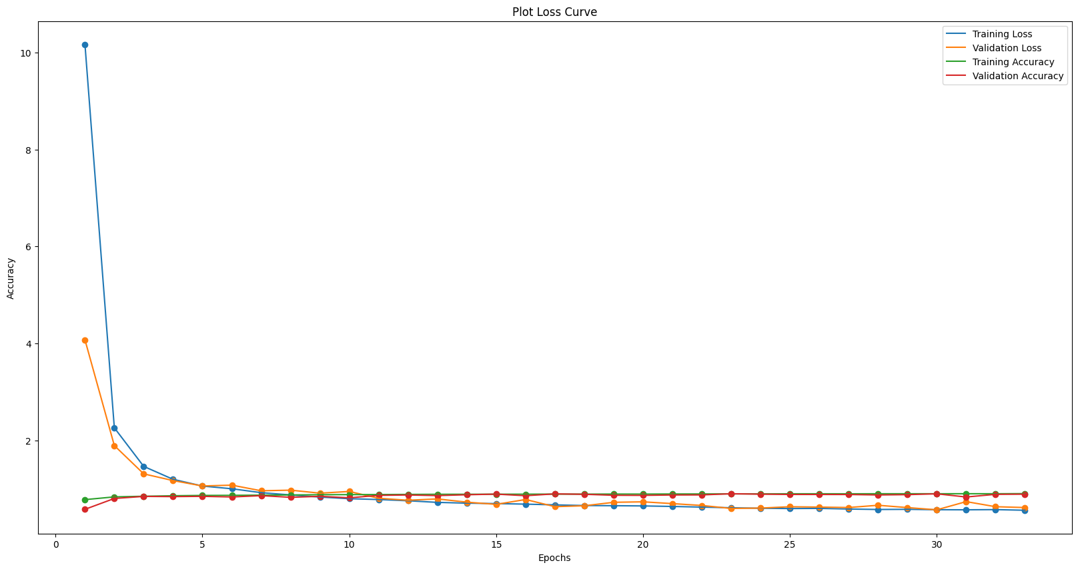
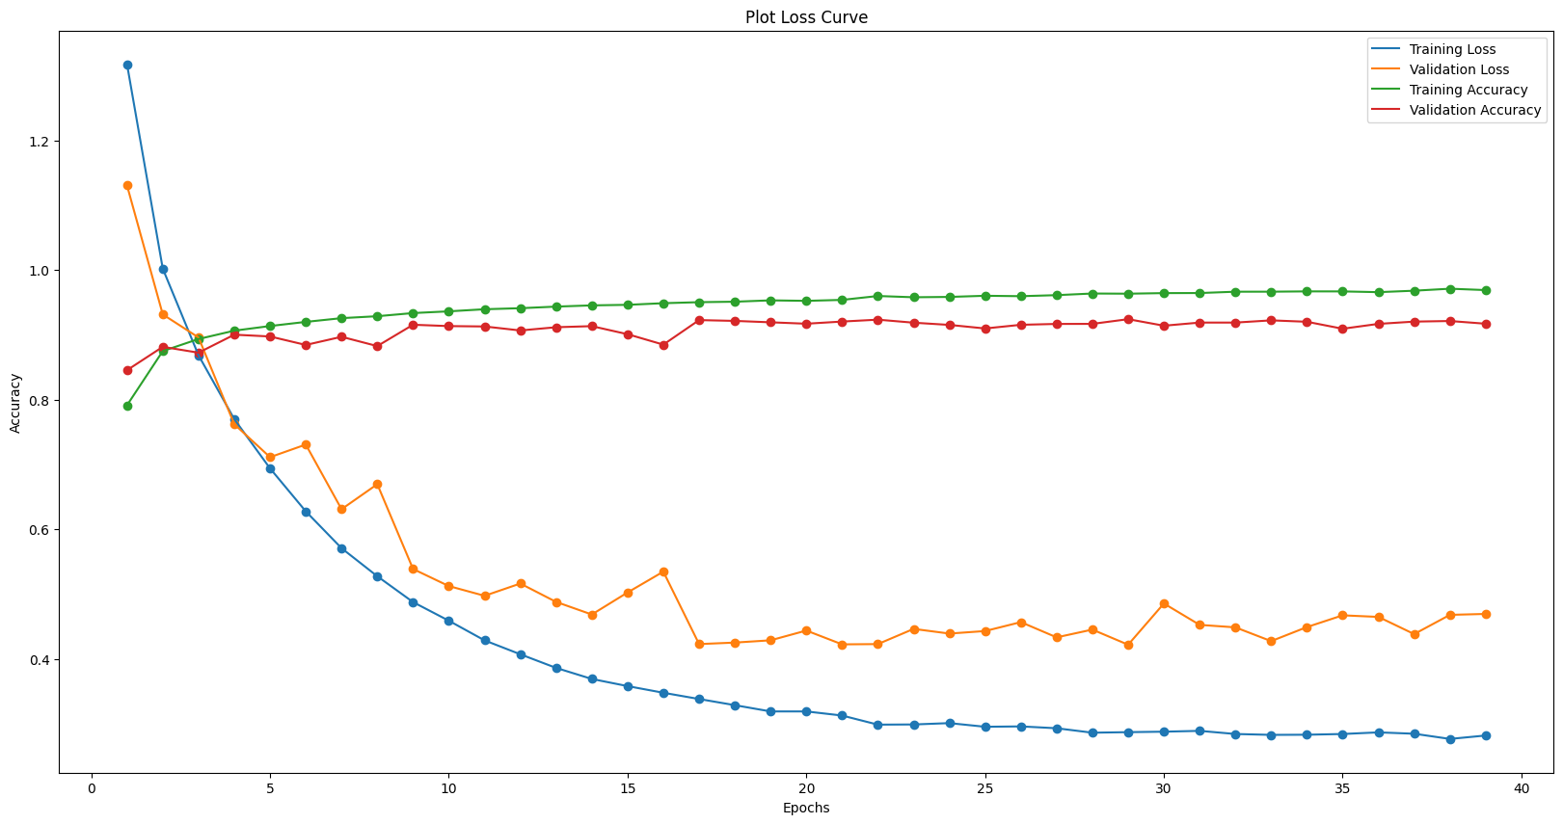
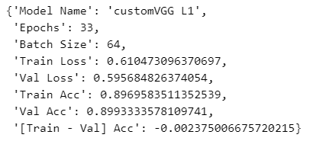
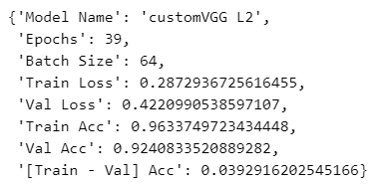
Model Improvement - VGG
As the model somewhat over fits, we will be using some regularisation methods.
L1 - Both training and validation accuracy decreased and the loss also increased which means that L1 does not make model better.
L2 - Both training and validation accuracy is very high as well as a low loss value compared to L1 and by apply the L2 regulariser, the model's performance increased. Therefore, we will be using L2 regularizer!

Slide 19
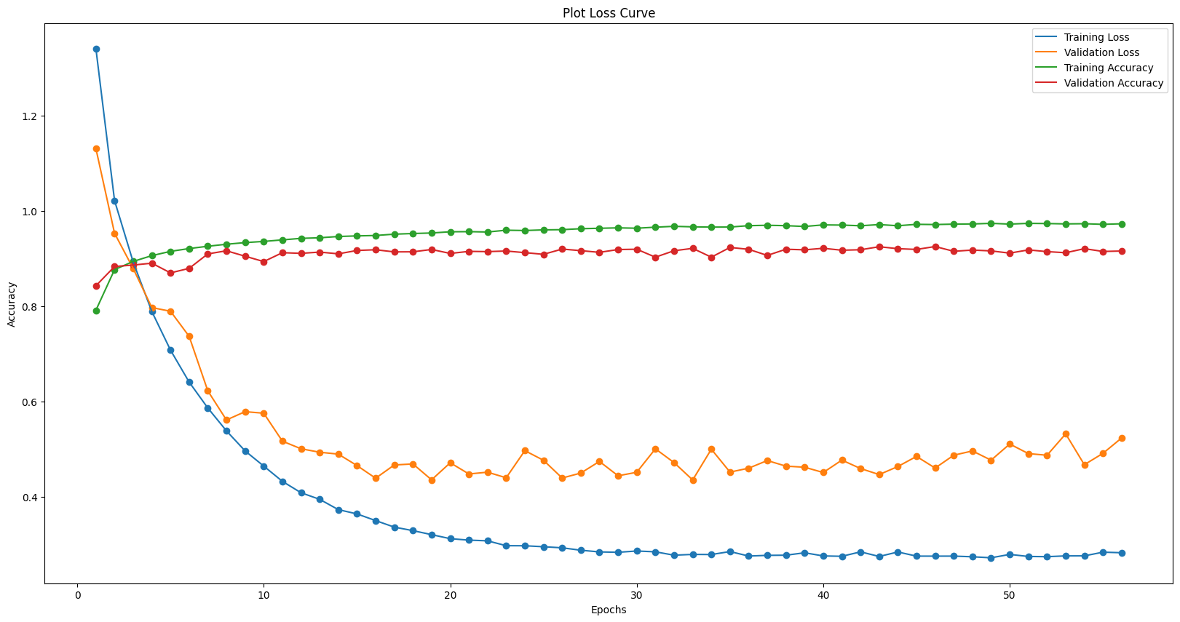
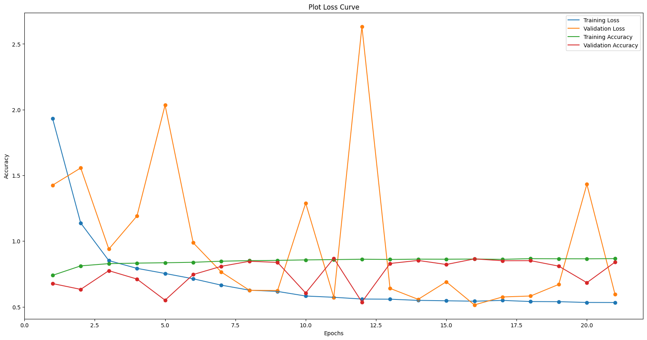
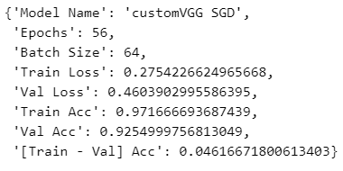
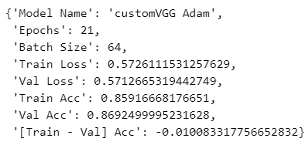
Model Improvement - VGG
SGD - Model is able to generalise and reduce loss
Adam - Model has many fluctuation and loss spikes up and down
We will be using the SGD optimizer as it very good at improving the accuracy and reducing overall loss compared to Adam. This suggest that both theoretically and practically SGD is better for this image classification problem.

Slide 20
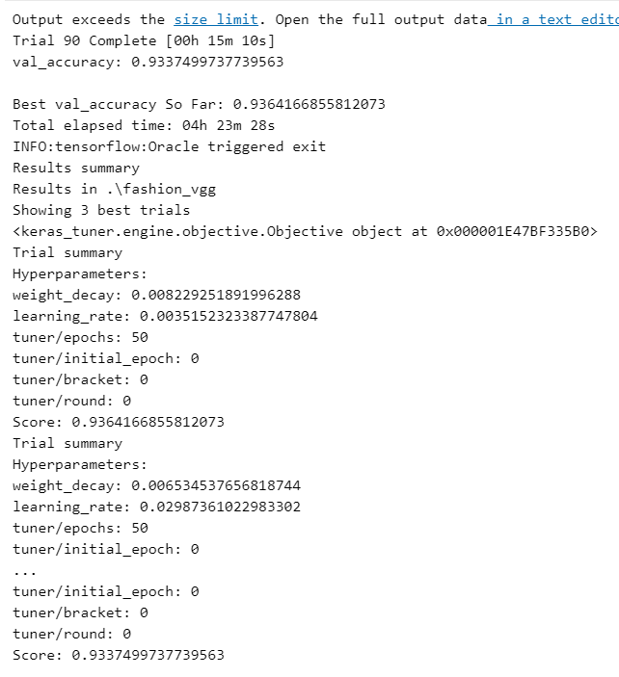
Model Improvement - VGG
For tuning, we will be tuning the learning rate and the L2 weight decay. We will be using Keras Tuner - Hyperband which is similar to the Grid Search CV in sklearn.
Weight Decay = 0.0003 - 0.01
Learning Rate = 0.001 - 0.1

Slide 21
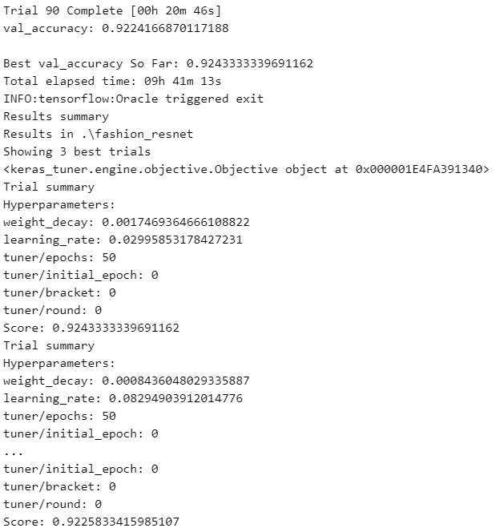
Model Improvement - ResNet
For the ResNet model, we will be trying a few things.
Using a learning rate scheduler [Cosine Annealing]
Using keras tuner to GridSearch to find the best parameters
For tuning, we will be using Keras Tuner - Hyperband
Weight Decay = 0.0003 - 0.01
Learning Rate = 0.001 - 0.1

Slide 22
Tuned Model Selection
After tuning the models, we will compare both models in terms of validation accuracy. We can see that customVGG is better than customResNet model as the validation accuracy is 0.9337499737739563 while the customResNet model has a validation accuracy of 0.9243333339691162.
Therefore after careful selection consideration, we will be using the customVGG model instead of the customResNet model

Slide 23
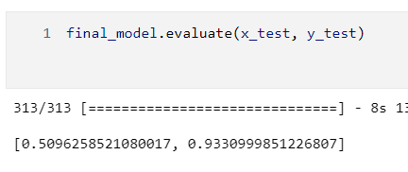
Model Evaluation
Now it is time to evaluate my final model. To ensure it generalise well, We want to ensure the accuracy on the testing set consistent with that on the validation set.
We note that the model loss and the accuracy is very high and is quiet similar to the loss and accuracy given by the validation set. This suggest that the model is good at generalising and predicting which image is what clothing item.

Slide 24
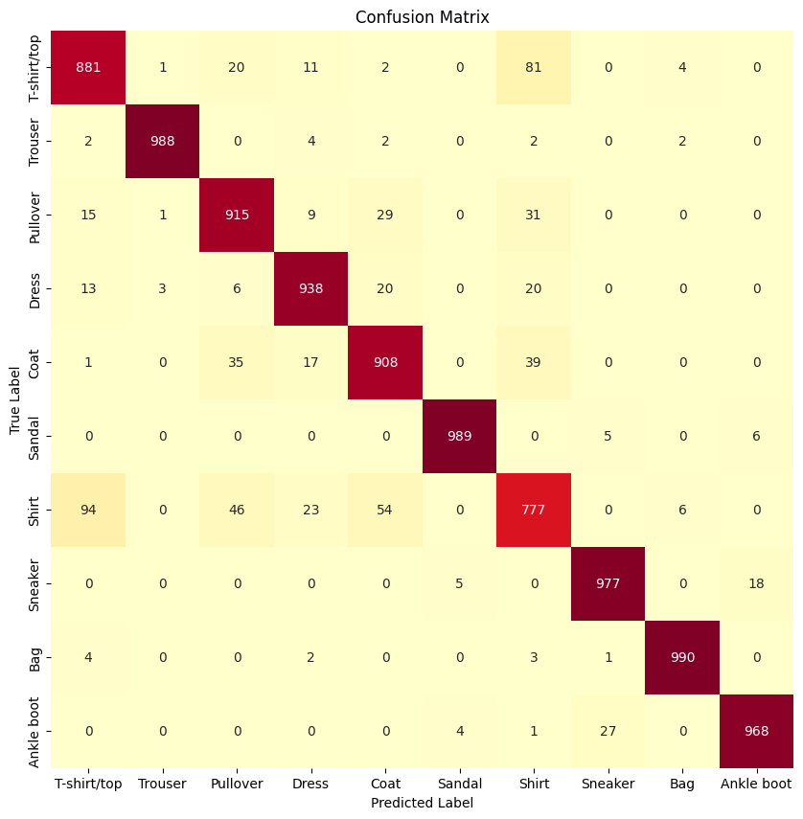
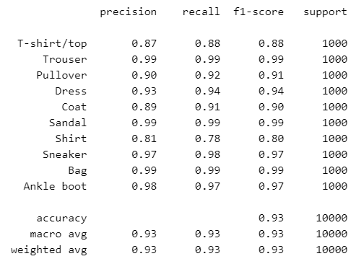
Model Evaluation
Based on the classification report the model is very good at identifying Trousers, Sandals and Bag but not very good at predicting Tshirt/top, pullovers and shirts.
We can see that the model is able to predict all the labels mostly correctly. However, the issue is the shirt class which is quite similar to the T-shirt/top class and other clothing items that is worn on the top. We will do a little error analysis to find out more.

Slide 25
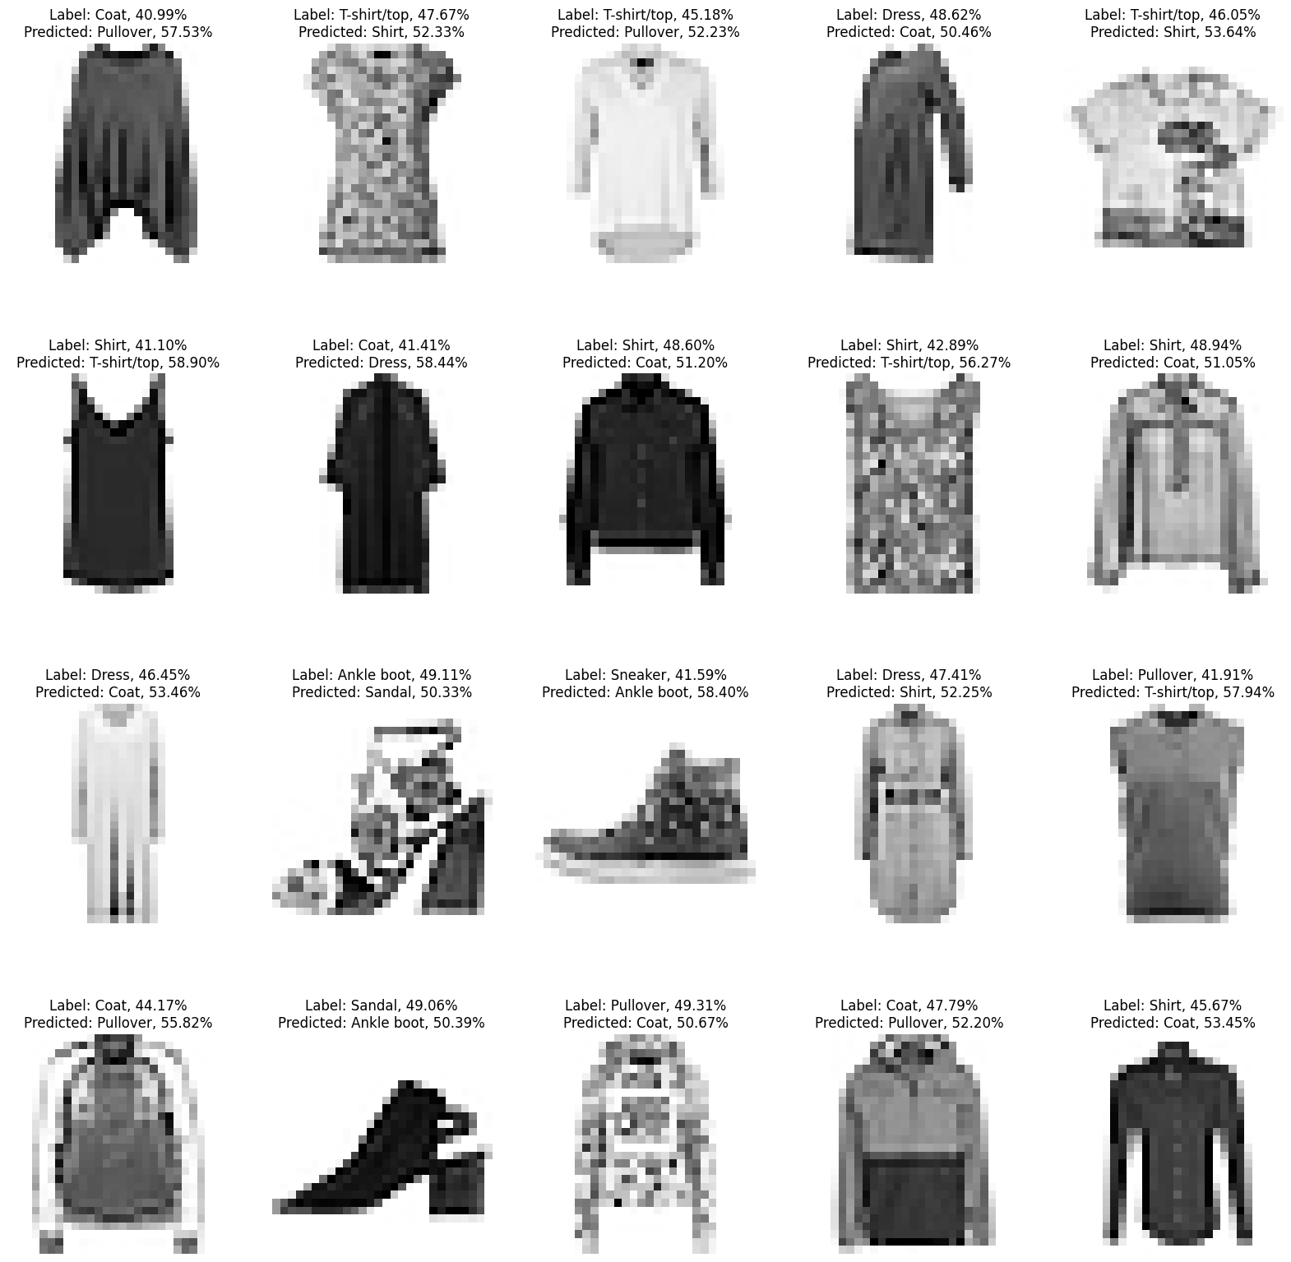
Error Analysis
When we look at the examples that the model made a wrong prediction, we can identify some reasons why it is the case.
Low pixel resolutions makes images hard to be distinguished.
Example: Row 4 Column 3
That images looks a bunch of pixels [Due to low resolutions] and it is hard to distinguish the features
Similar features
Example: Row 4 Column 4
The model predicted the values of a coat and pullover wrongly. This is likely due to both coat and pullover having long sleeves which we identified during our EDA could be a problem faced by the AI model.
Therefore, it appears that the model's mistakes are reasonable. In fact, real human performance was conducted by Zalando [Dataset creator] was only 83.5% accuracy. This shows that the model is performing quite well.

Slide 26
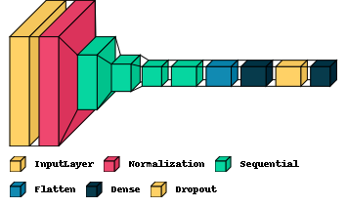
Summary
Based on PapersWithCode.com, our final model is ranked 11th out of the 13 models [Not inclusive of ours]. In summary, I experimented with various models, and found that a custom built CNN with batch normalization and data augmentation to try to reduce overfitting. More room for improvement can be made to the model like increasing the number of layers, using different learning rates and optimizers like RMSProp and Ftrl can be done to make model better.

